Slide 1
Working together …
The Canal partnership explained

Slide 2
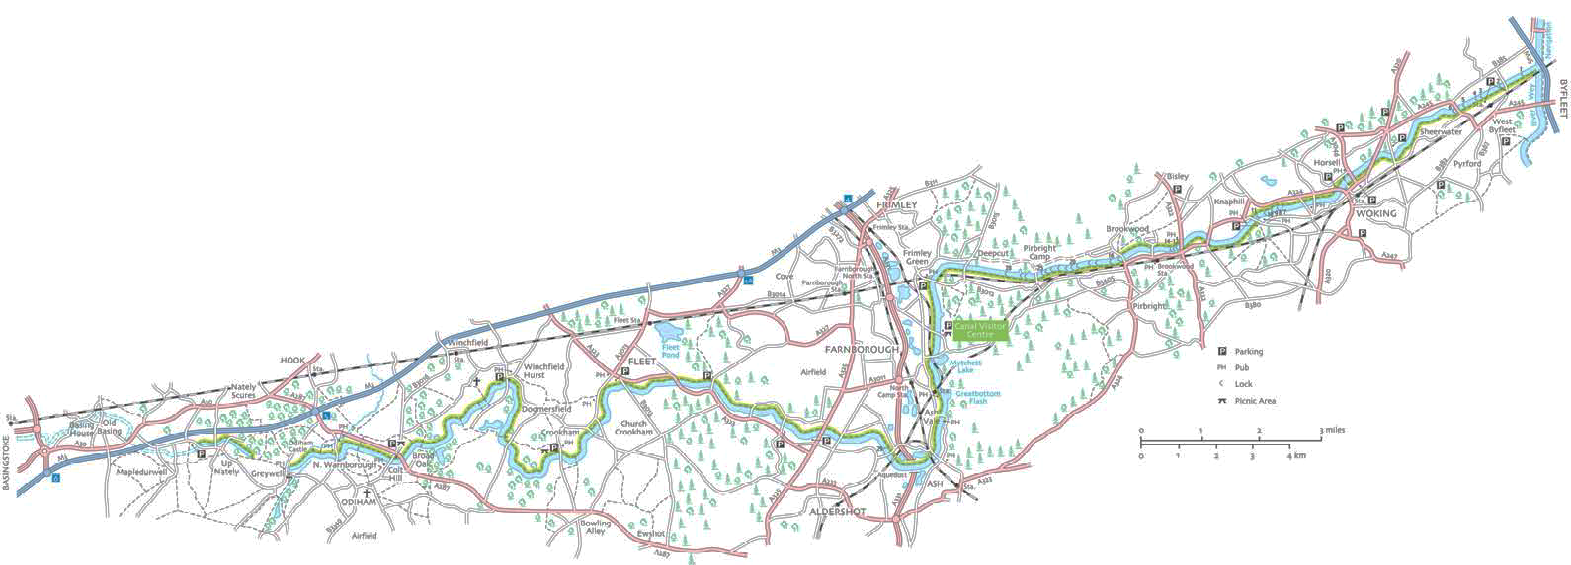
About ...
37 miles across Surrey & Hampshire - from River Wey Navigation at New Haw to Basingstoke
32 miles now navigable to New Haw - Greywell
29 Locks, 1 dry-dock, 3 aqueducts and 1 tunnel
Around 60% is raised above normal ground level – 142 sections of embankment

Slide 3
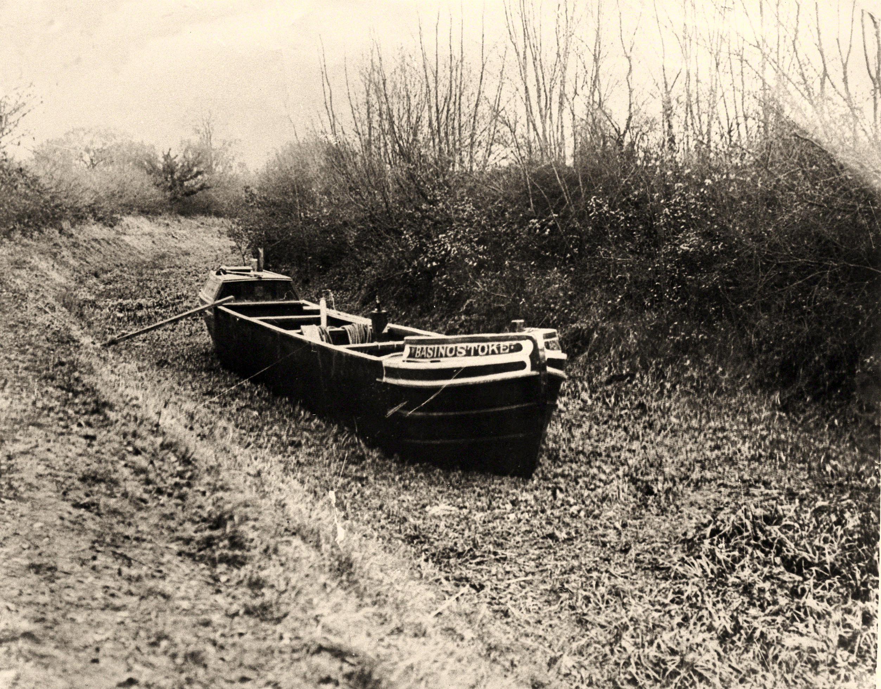
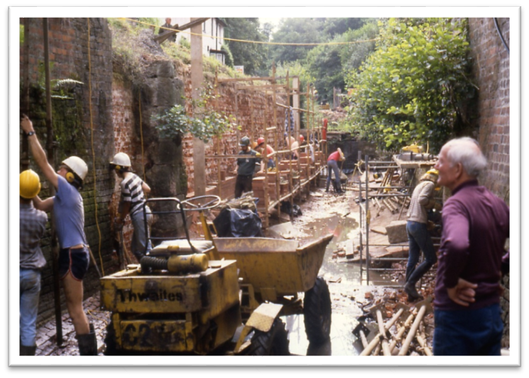
History
The first “agrarian” Canal - built speculatively on a tight budget 1792-8
Limited water supply – closed to barge traffic for first time in summer 1804 due to lack of water
Never lucrative, original company wound up in 1870s
Not Nationalised into British Waterways Board in 1962 as had ceased to be a public navigation in 1870s
Derelict by 1960 – purchased by County Councils as countryside for public recreation
Restored by County Councils and lots of volunteers 1974-1991
Currently managed by BCA – a local authority partnership
Photos courtesy - Basingstoke Canal Society
Notes:
Compressing 225 years of history into two slides

Slide 4
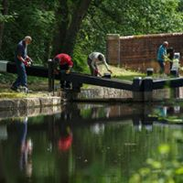
The Canal partnership... …working together
The Surrey and Hampshire County Councils own the Canal - carryout asset management through capital programmes
The BCA run the waterway - carryout day to day maintenance and operations
The BCS campaigns for the Canal - provide support through volunteers
Borough, District Councils and some Town / Parish Councils support the BCA through an annual revenue grant

Slide 5
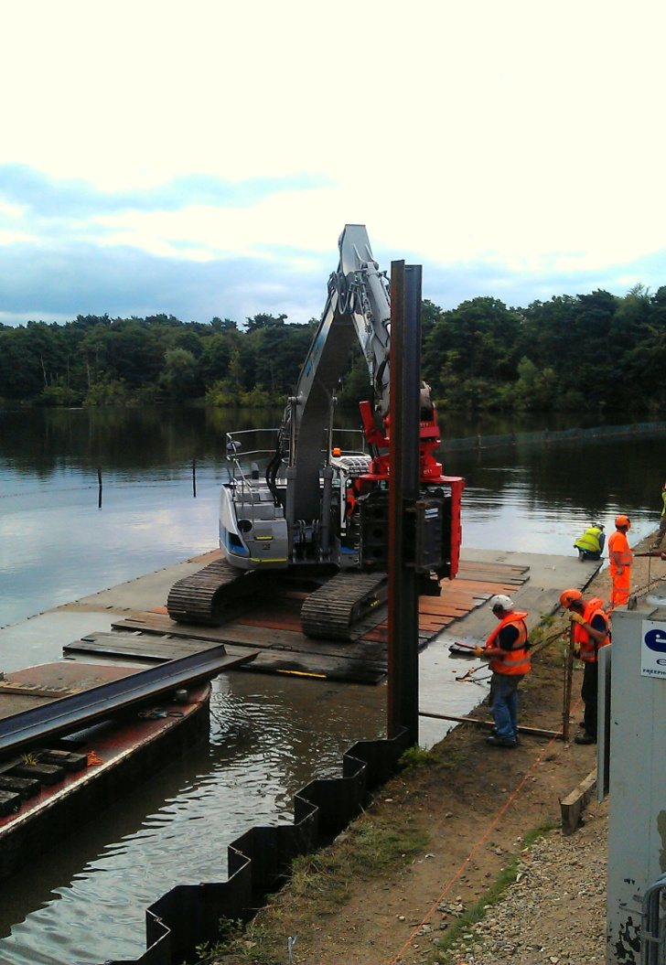
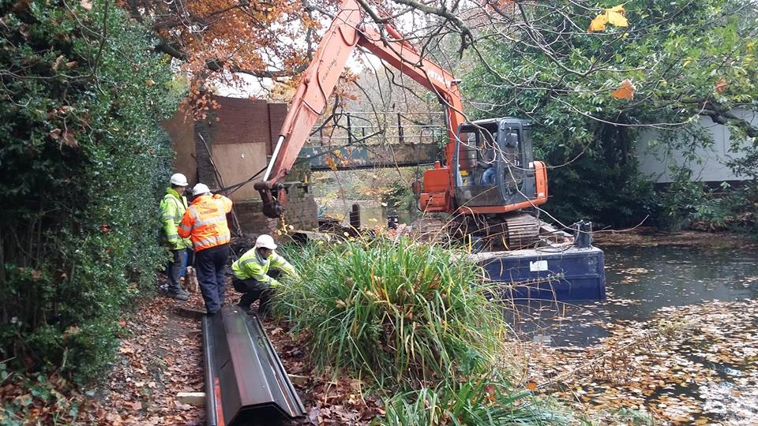
The County Councils …
Asset Management & Engineering expertise
Strategic Management, estates, financial oversight and hosting the Canal’s paid staff (eg: pensions, IT, etc.)
Political Governance – the JMC
Capital investment
Phase 1 - SCC/HCC £1.6m 2011-13
Phase 2 - SCC/HCC £4m* 2013-17
Phase 3 – HCC £1.5m 2018-21
- SCC £750k 2017-21

Slide 6
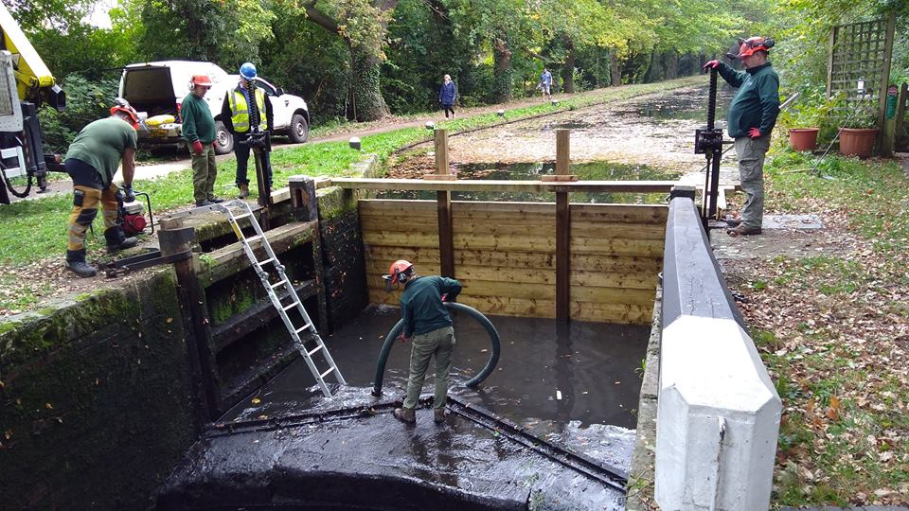
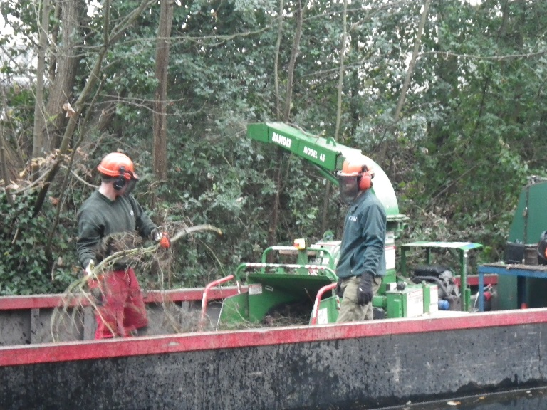
The BCA ….
Always have someone on duty
Manage water levels
Carryout regular detailed inspections
Planned and responsive maintenance
Support volunteer activities
Regulate use of the waterway and towpath
Provide visitor facilities

Slide 7
BCA revenue budget

Slide 8
BCA revenue budget

Slide 9
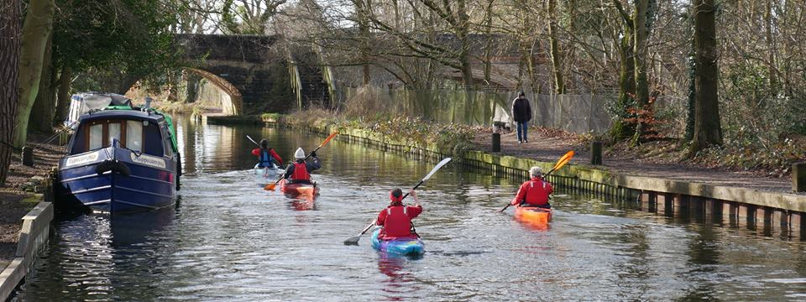
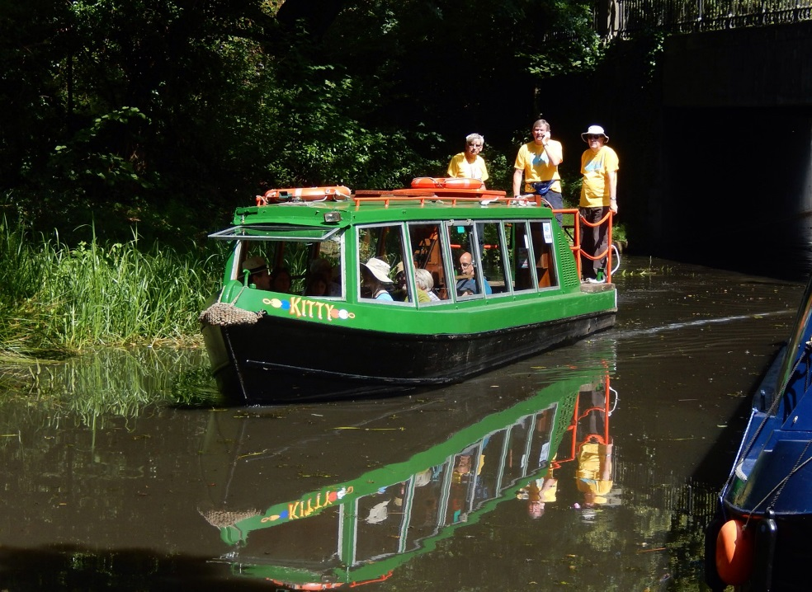
A valued resource
The County Councils purchased the Canal as countryside for public recreation
Over 1.7 million visits to the Canal per year – mostly on foot, bicycle or kayak
Recreation on the Canal contributes to the health & wellbeing of the population – £328 million over 25 years
Volunteers – we couldn’t manage it without them…
Make the waterway come alive - encouraging appropriate use
Help keep the waterway safe – eyes and ears
Help keep the viable for the future – help earn income to maintain the canal

Slide 10
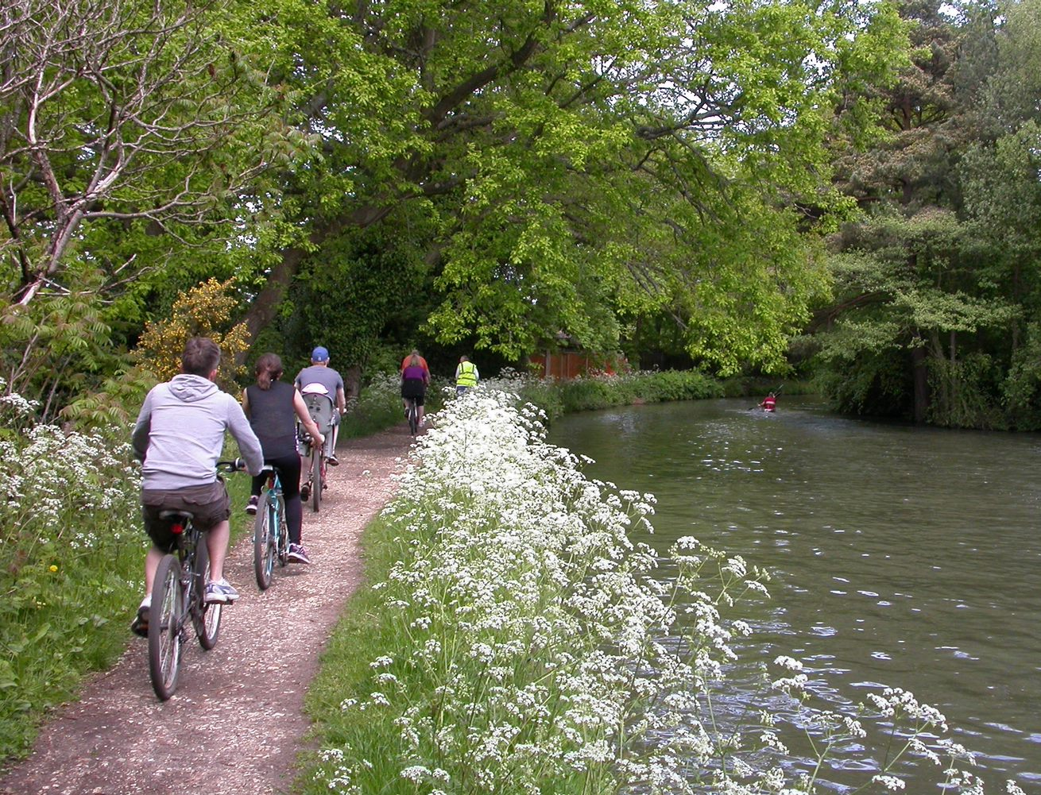
Plans for the future…
Making the BCA financial independent
Mytchett Canal Centre
campsite development (2021/22)
new visitor centre / café (2024/25)
Other visitor hubs / café (eg; Deepcut Lock cottage)
Parking charges
Maintenance & improvement
Funded regular maintenance programme
Lock gate replacement
Bank protection
Culverts
Embankments
Gravel path surfaces
Special projects
Deepcut – Brookwood towpath paving – s.106 (2022/23)
Improvements
Welcome & info signs
Benches

