Slide 1
Farnborough North and Hatches Level Crossing Project Overview

Slide 2
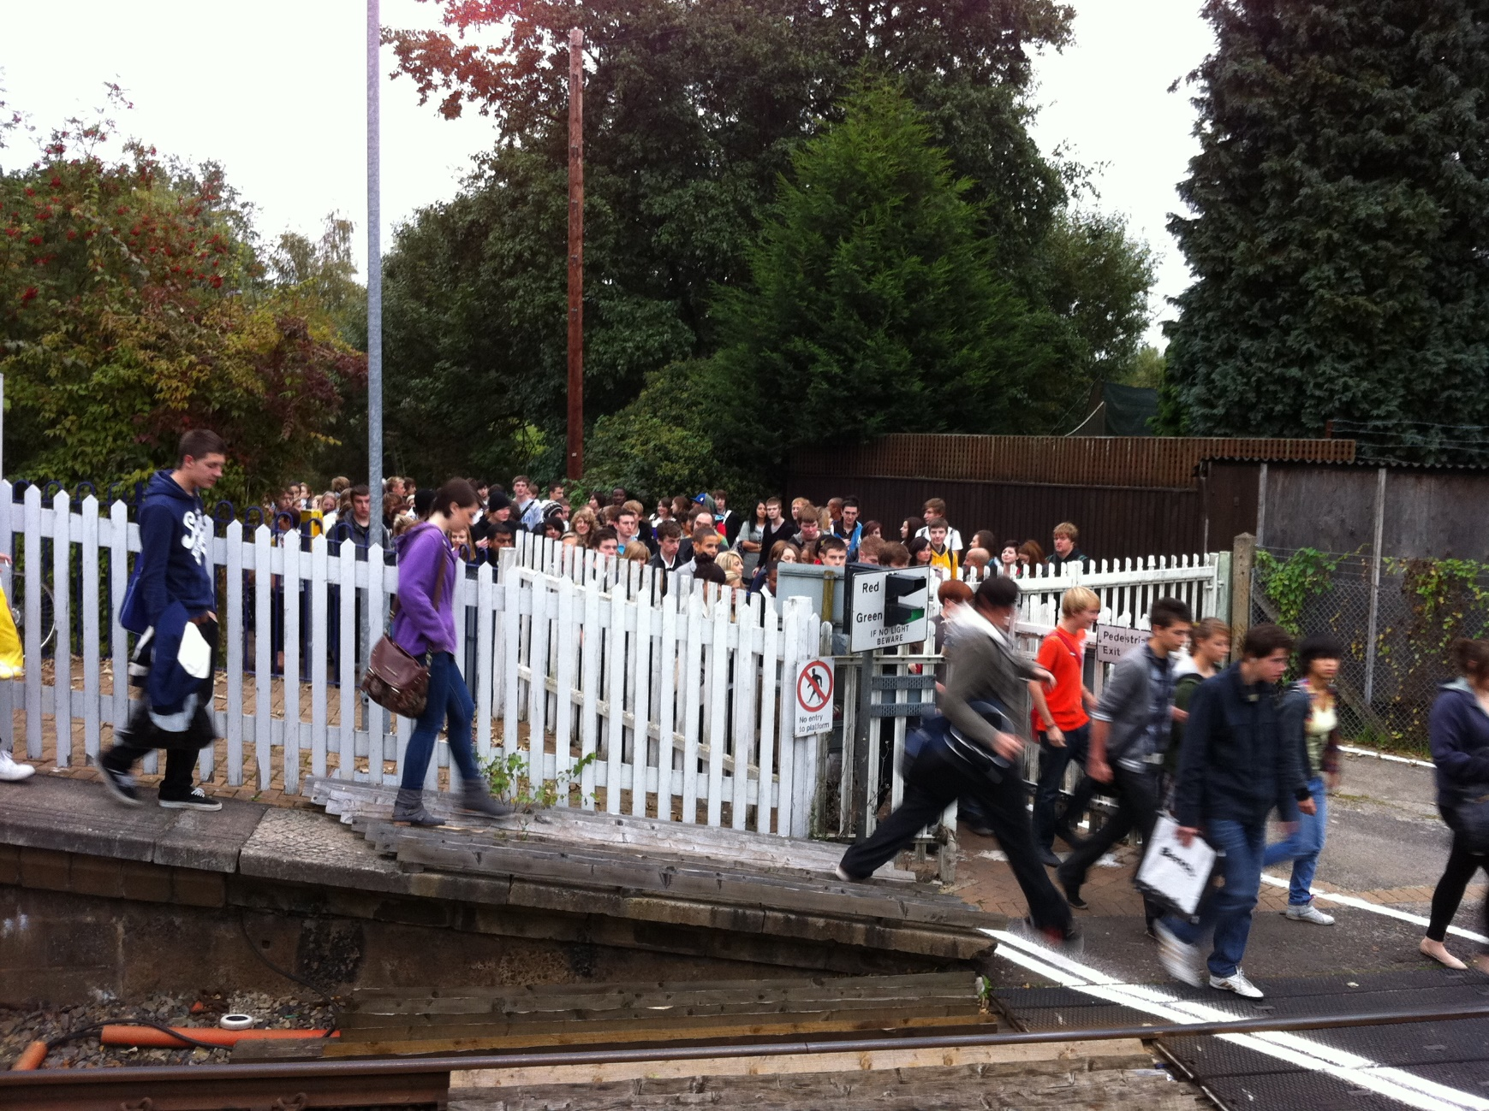
Safety Moment

Slide 3
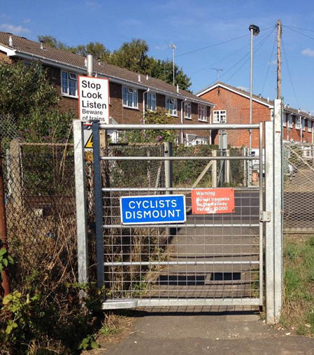
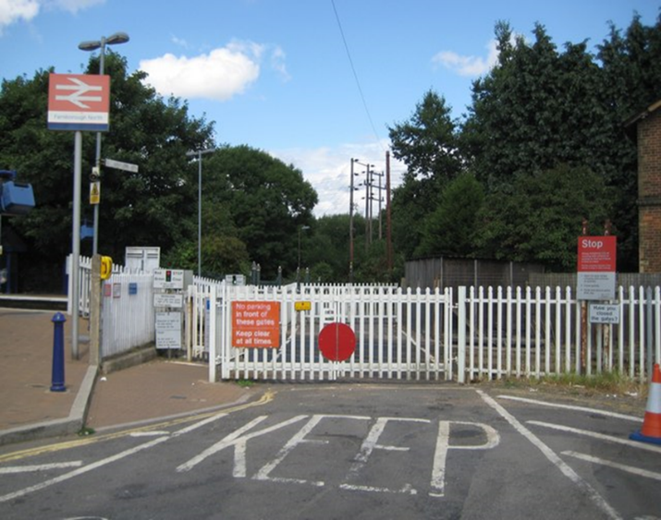
Objectives of the scheme
The key risk driver at these locations is safety.
Network Rail has a strict statutory duty to run a safe railway network and eliminate risks from it.
Level crossings are one of the key sources of catastrophic risk, we have a funded strategy to reduce it.
Farnborough North and Hatches are high risk footpath level crossings [ located in the surrey heath and Hampshire districts. Both routes serve as public rights of way routes] within our strategy.
Both crossings have significant and irremovable safety issues e.g. restricted sighting of trains at Hatches currently mitigated by trains sounding their horns.

Slide 4
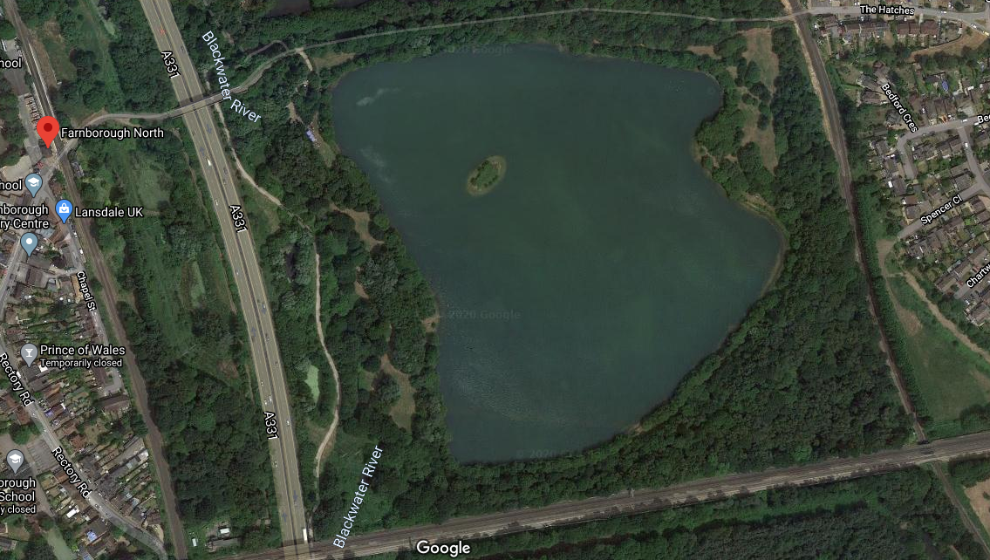
Introduction to Farnborough North
To facilitate UWC closure, existing bridge (“The Hatches”) requires replacement. – existing GRIP 2 report by Hampshire CC
Hatches Pedestrian Crossing – Closure of crossing with Stepped or Ramped FB at existing location or Spencer’s Close
ELR: AAV
38m 35ch
Farnborough North Pedestrian & UWC Crossing - Closure of pedestrian crossing with AFA style station FB ELR:GTW2
53m 11ch
To facilitate UWC closure, existing access road requires upgrading – existing GRIP 2 report by Hampshire CC
05/05/2022

Slide 5
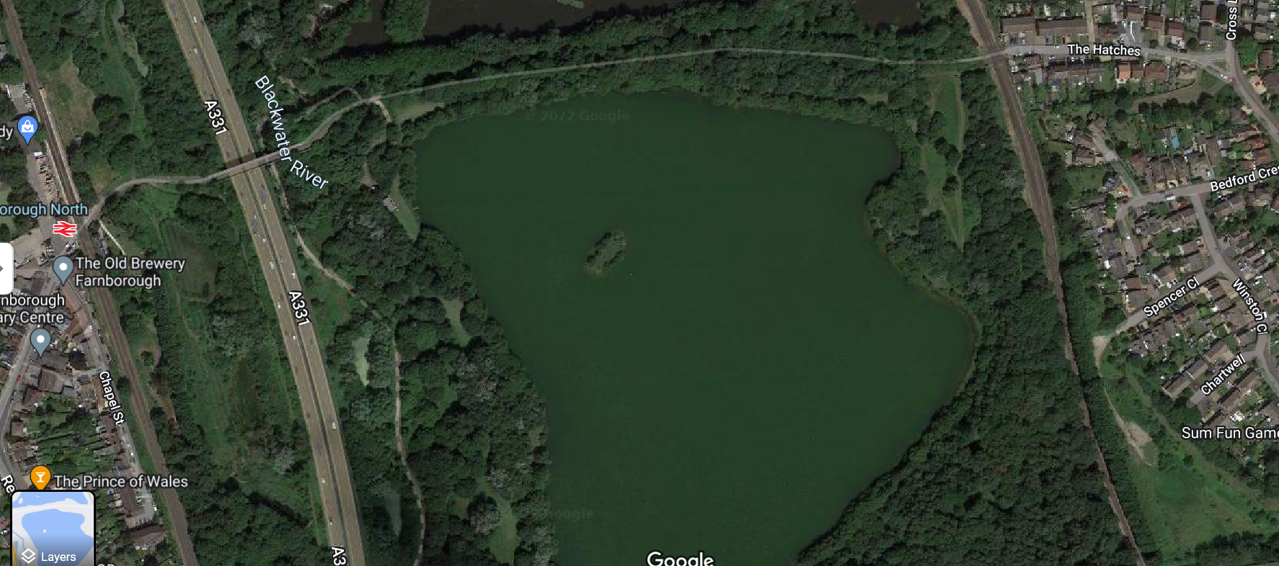
Proposed diversion route
This image shows the new diversion route. A new footpath will be created to the east of the fisheries to connect up to the existing footpath at Hatches.

Slide 6
Farnborough North LX
Farnborough North LX is located to South of Farnborough North station.
The Level Crossing is pedestrian & user worked with a site keeper in place.
Existing pedestrian crossing has a MSL warning system in place with wicket gates.
Crossings links residential areas of Frimley Green & Farnborough North.

Slide 7
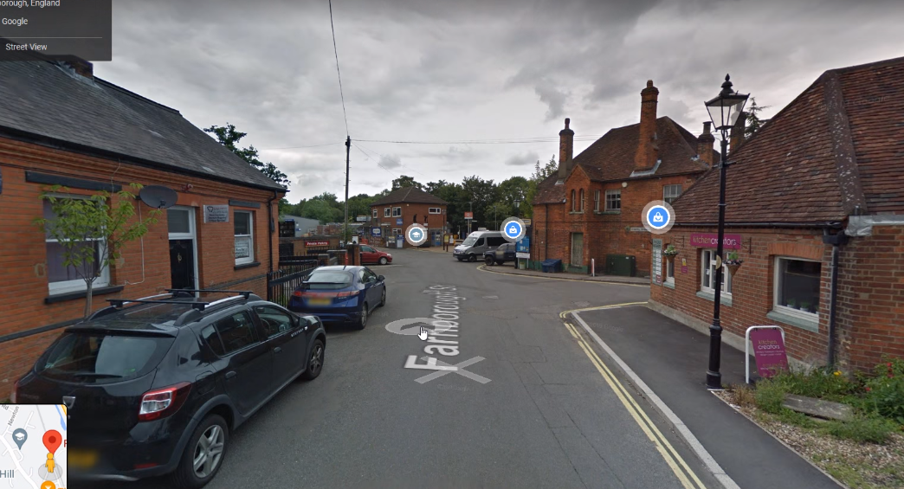
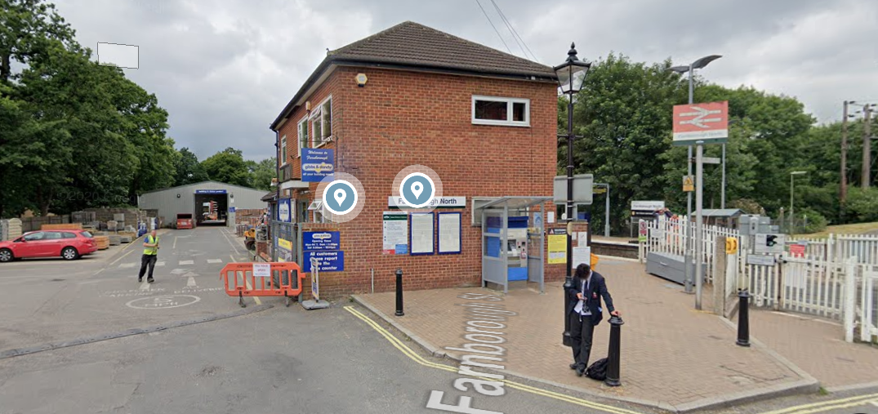
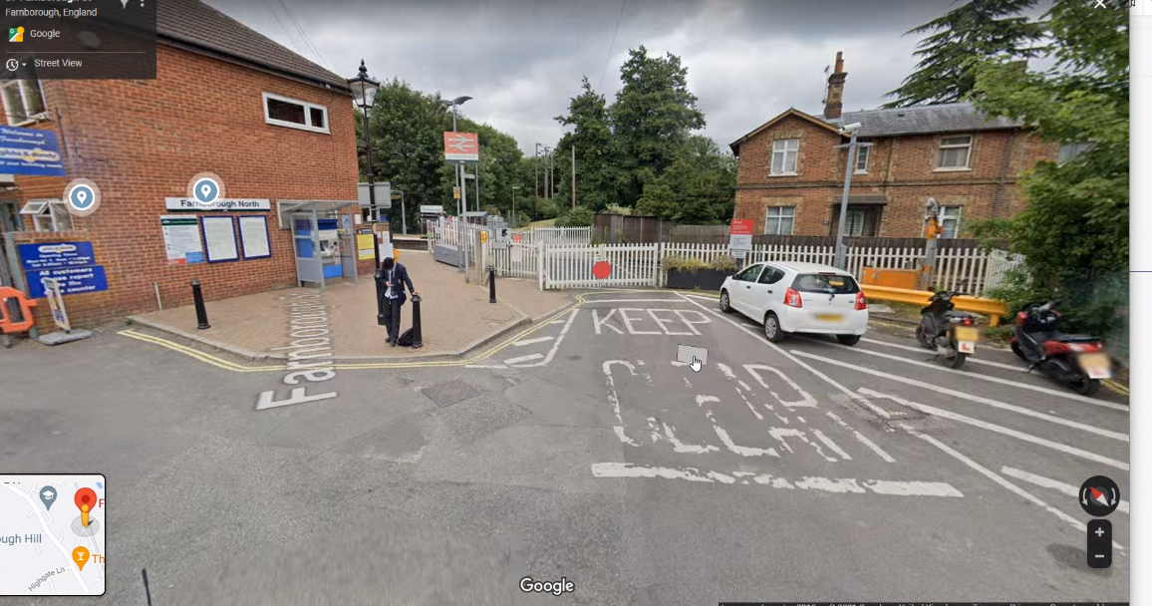

Slide 8
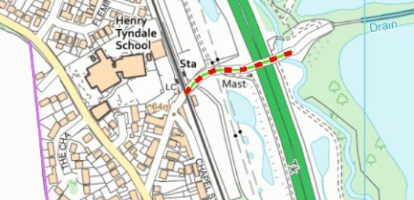
Public right of way
Farnborough North
Farnborough North level crossing carries bridleway 24. This scheme includes downgrading of it where it crosses the railway, to a footpath status and diversion onto a new footbridge.
Bridleway 24 is subject to a Traffic Regulation Order (TRO) which limits the use to footpath status only.
The new bridge at Farnborough North will include cycle gutters making it accessible for cyclists.

Slide 9
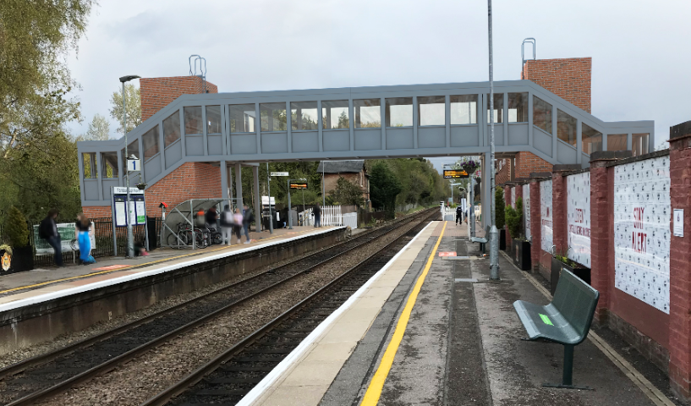
Farnborough North Selected Option

Slide 10
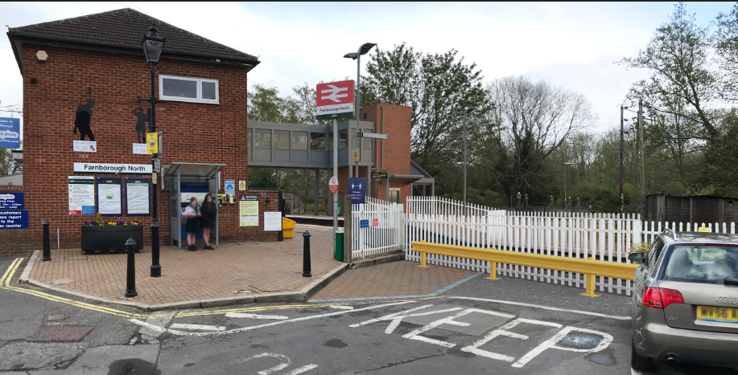
Farnborough North Level Crossing

Slide 11
Farnborough Selected Option
The height from the top of the lift shaft to the platform is 8.73m. The height from the top of footbridge roof to the platform is 7.16m.

Slide 12
Options at Farnborough North level crossing
Option | Viable? | Why/why not
Close the crossing with no alternative route | No | Essential pedestrian link. No platform to platform access
Close crossing and provide ramped bridge | No | Scale, incongruity and impact on surrounds
Close crossing and provide an underpass | No | Lack of space and flooding potential Propensity for anti-social behaviour
Retain the attendants, i.e. leave as it is now | No | Obsolete measure deployed by exception. Not a long term viable option due to cost
Reduce attendant hours | No | Exposes the public to risk when they are not present
Close crossing and provide stepped bridge | Yes | Provision of accessible solution neccessary

Slide 13
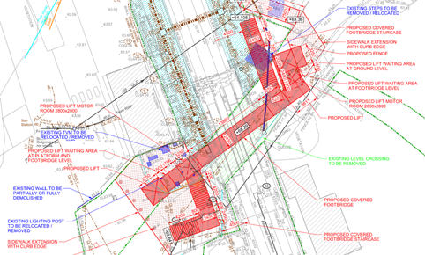
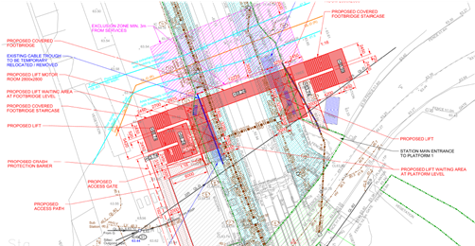
Farnborough other Options Considered
This option would require working between the Gibbs and Dandy office building and the gas main exclusion zone, West of the railway.
Construction works taking place nearer the existing level crossing pose risk of injuring members of the public.
More land take needed from third parties such as Gibbs and Dandy and Sawyer land
Temporary railway crossing with appropriate access would have to be established.
The proposed structure is located above the existing level crossing, which would require diversion of a large number of services running below the existing level crossing prior to installing the structural foundations.
Work taking place adjacent to residential buildings. This option requires a large amount of buried services to be relocated/diverted.

Slide 14
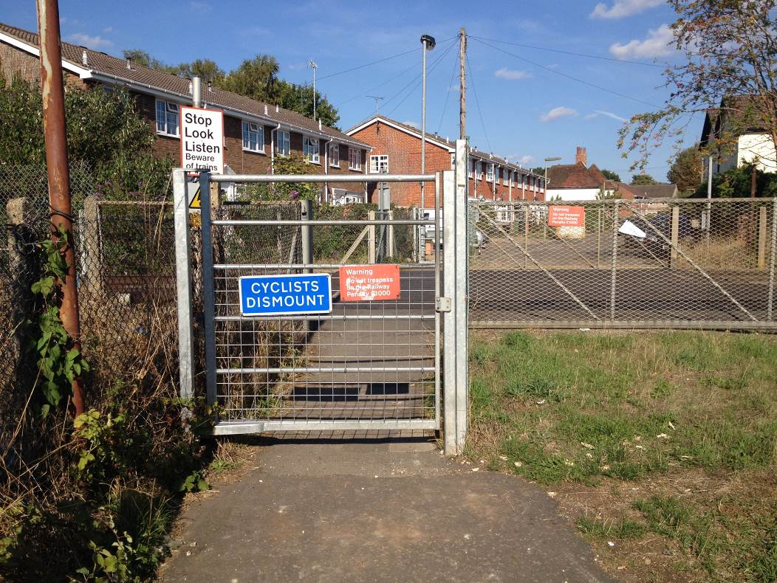
Hatches level crossing
Hatches is a public footpath crossing located in Frimley Green, Surrey. It lies between Frimley & Ash Vale Stations on the AAV line.
The crossing is surrounded by a residential estate to the east and private fishing lakes to the west linking to Farnborough North level crossing
Protection method at the crossing is signage and whistle boards only.
The crossing is well used by dog walkers, cyclists, commuters and visitors to the fishing lakes.
Notes:
For the majority of users, their journey will continue along the footpath and over Farnborough North footpath crossing approximately 400m away on a parallel railway line (GTW2). The crossing at Farnborough North has Miniature Stop Lights (MSL) in situ.

Slide 15
Safety at the Hatches level crossing
Network Rail’s legal duty to protect the public
Risk assessment
High risk site
Hatches level crossing issues:
Non-compliant sighting
Vulnerable users
Near miss events
We are not meeting our legal duty to bring the risk to its lowest levels

Slide 16
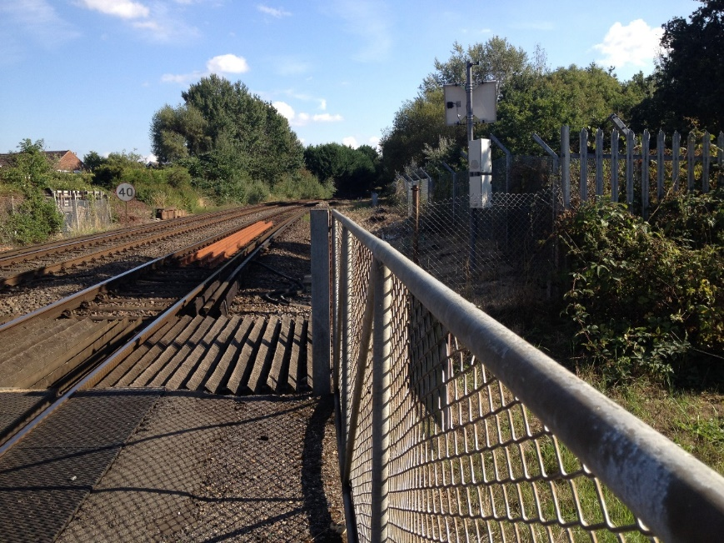
Safety at Hatches level crossing
There is not enough time to cross safely by people spotting approaching trains.
Whistle boards and audible warnings already installed.
Even with these mitigations, the misuse, both deliberate and accidental, has continued resulting in 7 near misses in the last five years.
A near miss classified by the train driver applying the emergency brakes as so close.
Notes:
16-Mar-20 LC Near Miss - 2N48 (SWR 15:30 Aldershot to Ascot) reported a near miss with a person running across Hatches crossing
24-Jun-19 Deliberate misuse - A male with a bicycle was going to across and came to a stand as train was approaching at Hatches Level Crossing.
18-Sep-18 LC Near Miss - 2N56 (SWR 17:00 Guildford to Ascot) had a near miss at Hatches crossing near Camberley with a person wearing headphones that had crossed in front of the approaching train
13-Sep-18 Near miss - 5N10 07:23 Aldershot - Ascot t Hatches (UW) level crossing, Frimley Green, with two individuals who crossed against the approaching train. No EBA applied.
24-Apr-18 Deliberate misuse - 2N58 1839 - the driver came across someone crossing the footpath. Driver blew the horn and the person stepped back to a position of safety.
04-Oct-17 Near miss - 2N13 0845 - Youth with headphones went to walk over crossing and realised train presence and moved clear before driver could apply emergency brakes.
18-Sept-17 Near miss - 2N46 1430 - Driver stated that the female stepped out on to the crossing, the driver blew the horn and she stepped back of the crossing out of the way
11-Aug-17 Near miss – 1546 2N41 (1523 Ascot - Guildford) has reported a near miss at The Hatchers with two Cyclists. The cyclists were not moving quickly so the driver had to apply the emergency brake.
26-Jun-17 LC Misuse - 2N45 (1623 Ascot - Guildford) reported a man crossing over The Hatches foot crossing in front of his train. Nr Frimley Station.
18-May-17 Near miss - At 1715 2N47 1653 Ascot - Guildford reports a MOP ran across the front of their train. Driver applied emergency brakes and stopped short of person.

Slide 17
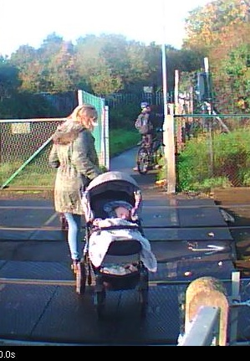
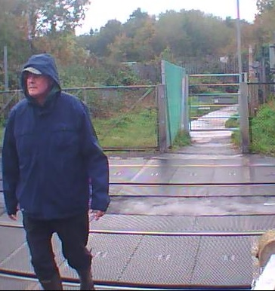
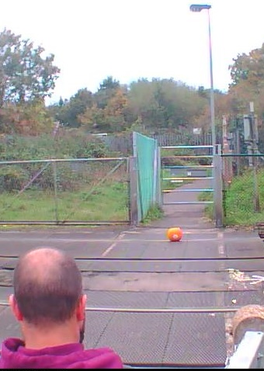
Use and misuse of Hatches crossing
Object placed on line
Pram dragged backwards
Hooded person with limited vision
All four slide photos from a two day sample

Slide 18
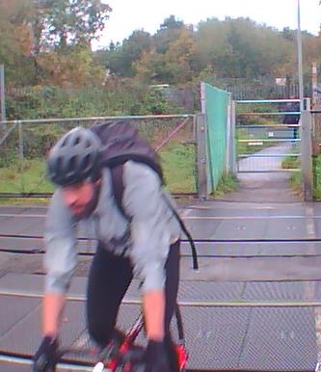
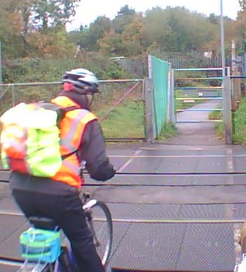
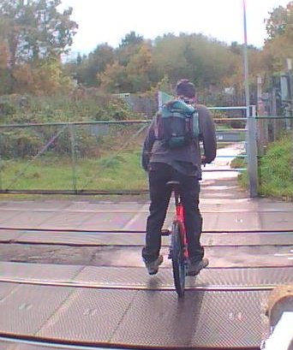
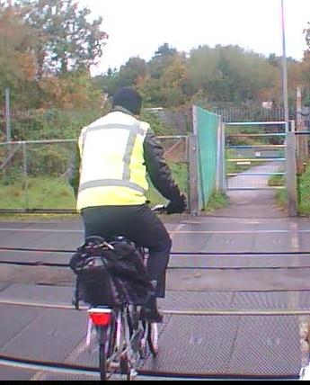
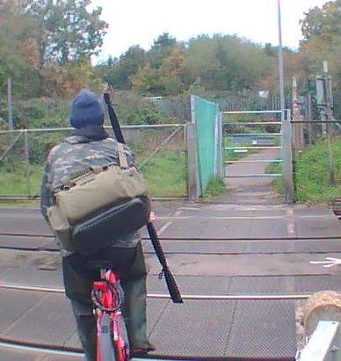
Mounted cyclists

Slide 19
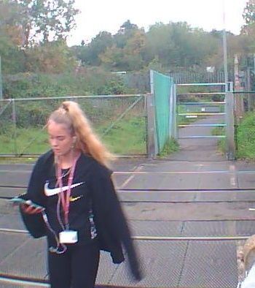
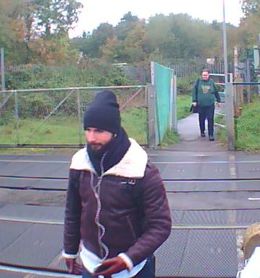
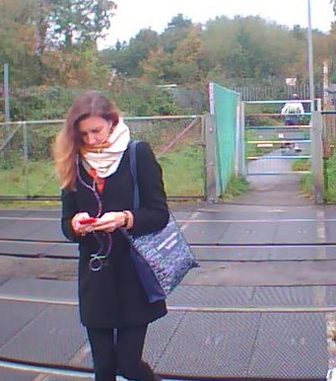
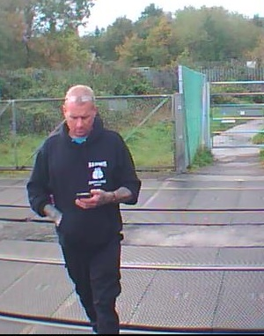
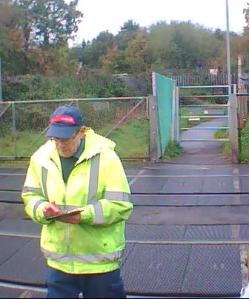
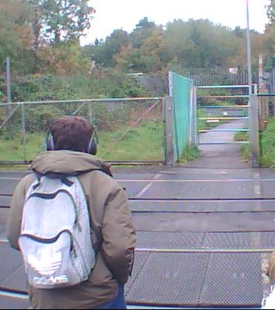
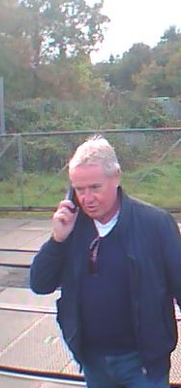
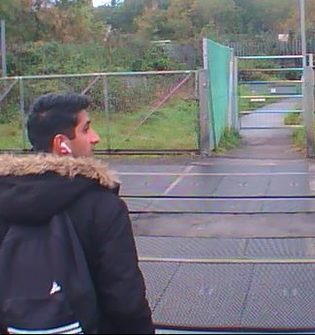
Mobile phone and headphone distraction

Slide 20
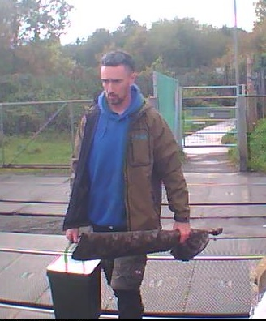
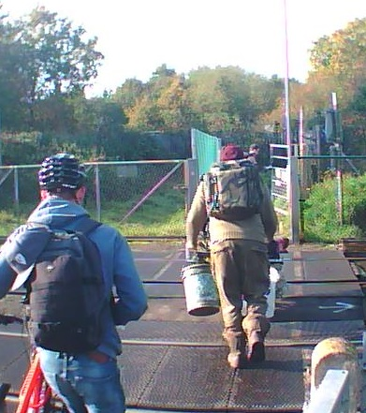
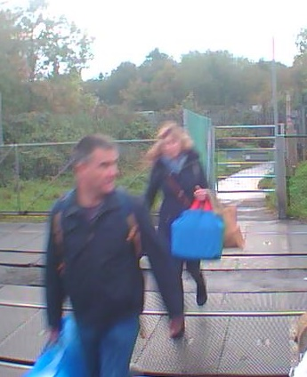
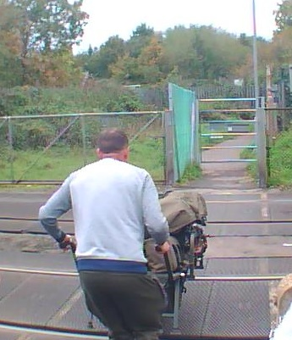
Encumbered users

Slide 21
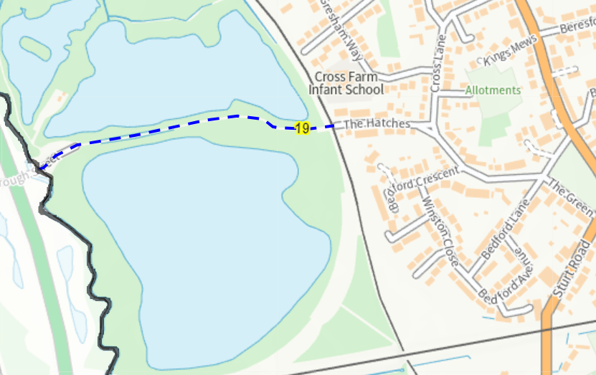
Public right of way
Hatches crossing
Hatches carries bridleway 19. This will be diverted from the crossing to the new accessible footbridge at Spencers Close.
Bridleway 19 is also subject to a TRO as it crosses the railway.
The section of the diversion route on the proposed bridge will be a public footpath only.

Slide 22
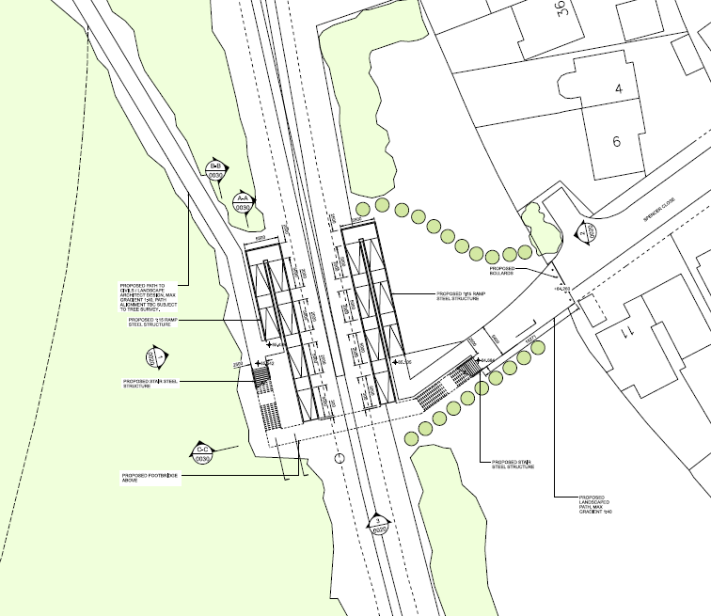
Hatches Selected Option
Option 3b - This option proposes the closure of The Hatches level crossing and installation of a new footbridge with 2No. stacked ramps and 2No. staircases, south of the existing Hatches level crossing at Spencer Close
Notes:
Option 3b - This option proposes the closure of The Hatches level crossing and installation of a new footbridge with 2No. stacked ramps and 2No. staircases, south of the existing Hatches level crossing at Spencer Close.

Slide 23
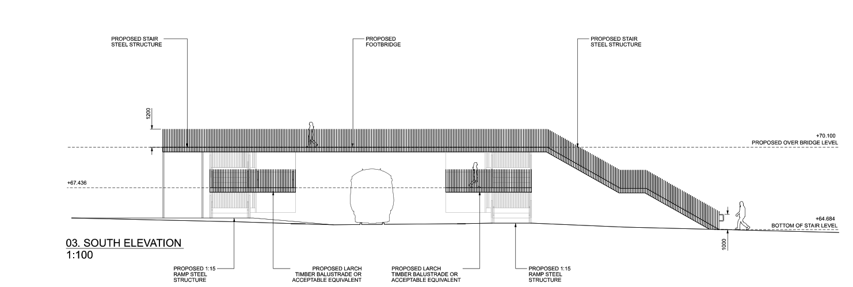
Hatches Selected Option
This image shows the elevation of the proposed footbridge.
The structure varies in height but is roughly 6m at its highest point (main span to floor).
Material wise the bridge will be fabricated of steel and painted in a colour of NRs choice.

Slide 24
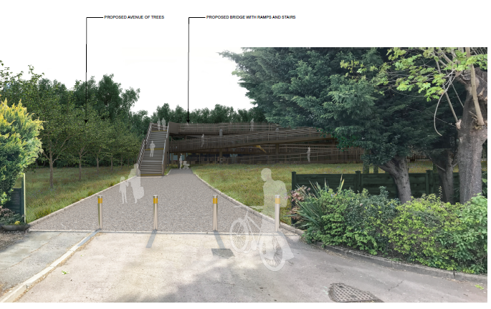
Hatches selected option
Notes:
Visual 1 – From Spencer Close

Slide 25
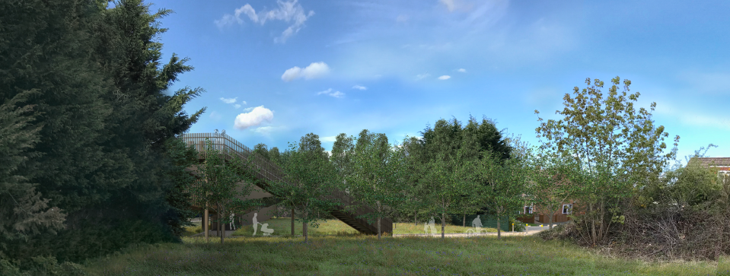
Hatches selected option
Notes:
Visual 2 – From South facing

Slide 26
Options at Hatches level crossing
Option | Viable? | Why/why not
Close the crossing with no alternative route | No | Essential pedestrian link between Frimley and Farnborough No suitable alternative nearby
Close crossing and provide stepped bridge | No | Accessible solution required
Close crossing and provide an underpass | No | Spatial constraints at the crossing High likelihood of flooding issues and anti-social behavoiur
Install Miniature Stop Lights like Farnborough North | No | Risk is reduced but not to a suitable level. Misuse continues. Disproportionately costly relative to the benefits achieved
Keep as it is | No | Intolerably high risk. NR not fulfilling legal its core obligations
Locked Gates | No | Potential for trapping people can only be overcome by having an attendant
Close crossing and provide ramped bridge | Yes | Costly, but eliminates risk and provides long term solution

Slide 27
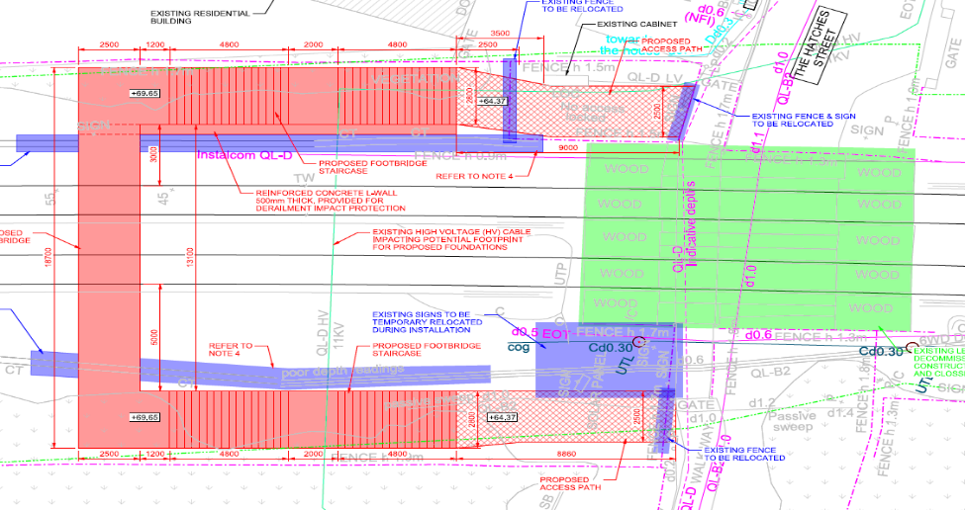
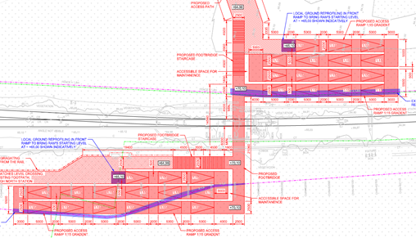
Hatches Other Options Considered
This option is over the current level crossing. No space for a site compound.
Would require disruption to The Hatches street for material drop off.
Tree Preservation Order in place to the North-Eastern side.
Not providing level access would prevent less able pedestrians from crossing the tracks.
Wide ramps nearby Spencers Close – more land take needed.
Extensive de-veg required east and west of the tracks.
Requires the most man hours (increasing overall risk).

Slide 28
Conclusions
Both crossings are unsafe and something needs to change.
We propose to close the level crossings.
Both are being offered alternative methods of crossing the line in a safe manner.
Any Questions?
Email: Lilli.slade@networkrail.co.uk

